Slide 1

Progress Seminar On WEBSITE ON LEARN HOW TO CODE
Presented By
Vaishnavi Belekar
Guided By
Mrs. Roshani Talmale
Department of Computer Science & Engineering
S. B. JAIN INSTITUTE OF TECHNOLOGY MANAGEMENT AND RESEARCH,NAGPUR
An Autonomous Institute, Affiliated to RTMNU, Nagpur

Slide 2
Contents
Objectives
Introduction
Literature survey
Website Design
Technology to be Used
Modules
Screenshots
Advantages & Applications
References
S. B. Jain Institute of Technology Management and Research
2

Slide 3
Objectives
To Reduce efforts of user.
To Provide full satisfaction to user.
To Provide easy access to the user.
S. B. Jain Institute of Technology Management and Research
3

Slide 4
Introduction
For this project, I created a website named as website on learn how to code in which I used HTML, CSS programming language. For my project I wanted to work on web development so I created this webpage by taking idea from various coding website. Users will be able to use the website to know about different programming language. In this website I created different sections / pages for detailed information about programming language where users can visit easily directly through menu bar.
S. B. Jain Institute of Technology Management and Research
4

Slide 5
Literature Survey
Websites / Paper / Article | Reviews / Finding
https://www.w3schools.com/ | Content are good. Use of animation are impressive
https://www.geeksforgeeks.org/ | 1. Simple but attractive 2. Styling as done accurately
https://html.com/ | 1. Content are good but background is not matching with the website.

Slide 6
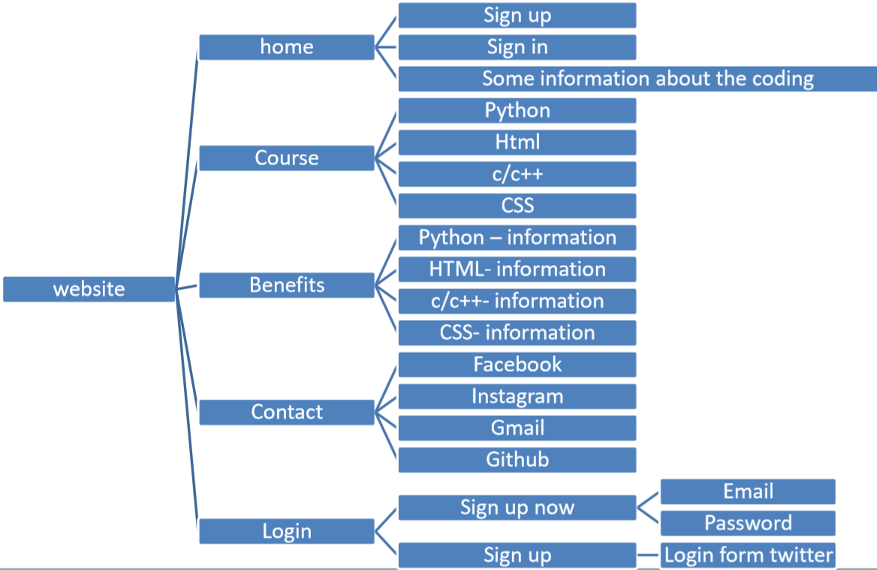
Website Design: Flowchart
S. B. Jain Institute of Technology Management and Research
6

Slide 7

Use case Diagram
start
View navbar
Select item
login
Register
View menu
Select page
View page
close

Slide 8
Technology to be Use
Front End:
HTML, CSS
IDE:
vs code
Hardware used:
Laptop , Computer and android phone
S. B. Jain Institute of Technology Management and Research
8

Slide 9
Modules
Module Names
1. Home
2.Course
3.Benefits
4.Contact
5.Login
S. B. Jain Institute of Technology Management and Research
9

Slide 10
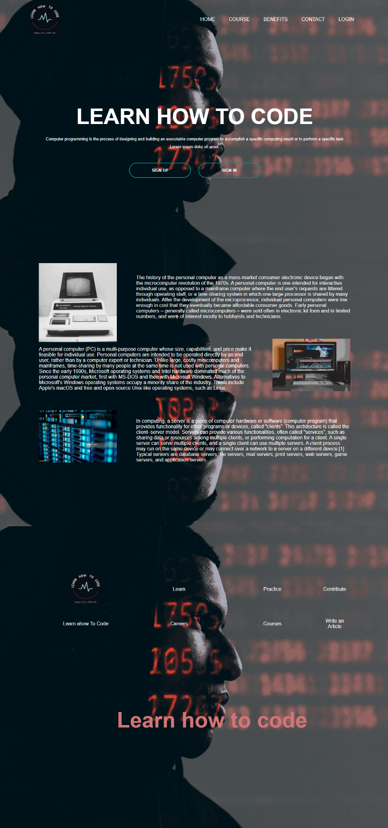
1. Home
We see in a home page there is a two button for sign up and sign in and some information
about old computer , modern computer and server

Slide 11
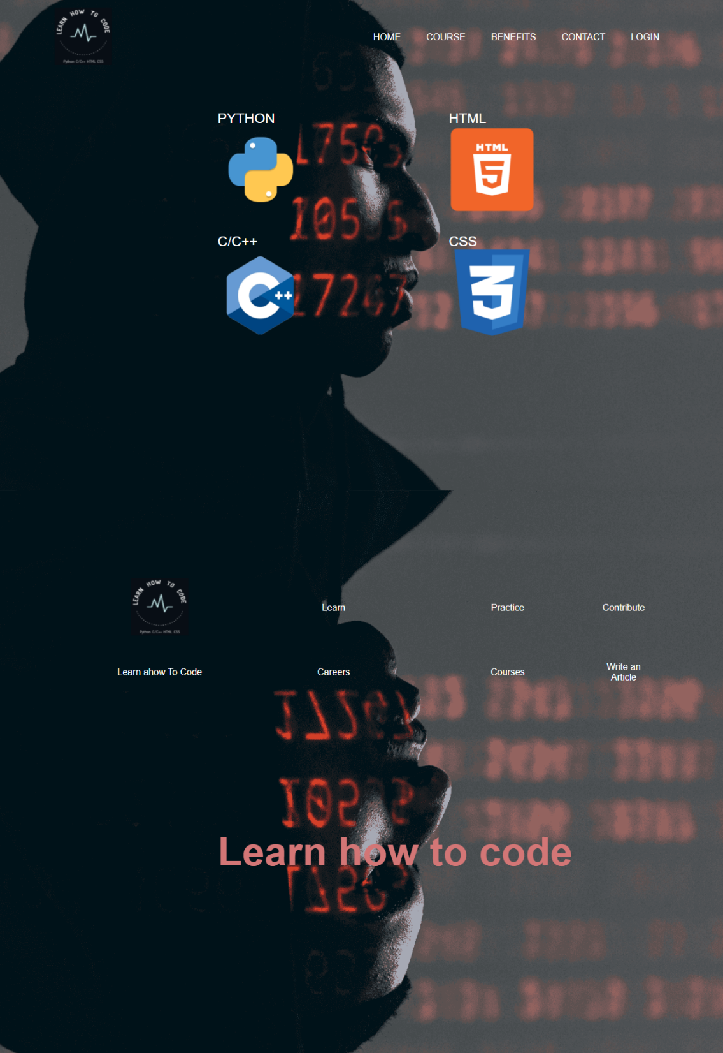
2.Course
When we click course it open new page it content courses like python, html , css and
c/c++ . When we click on any porg languages it redirect to the course page it is same for
all the prog languages.

Slide 12
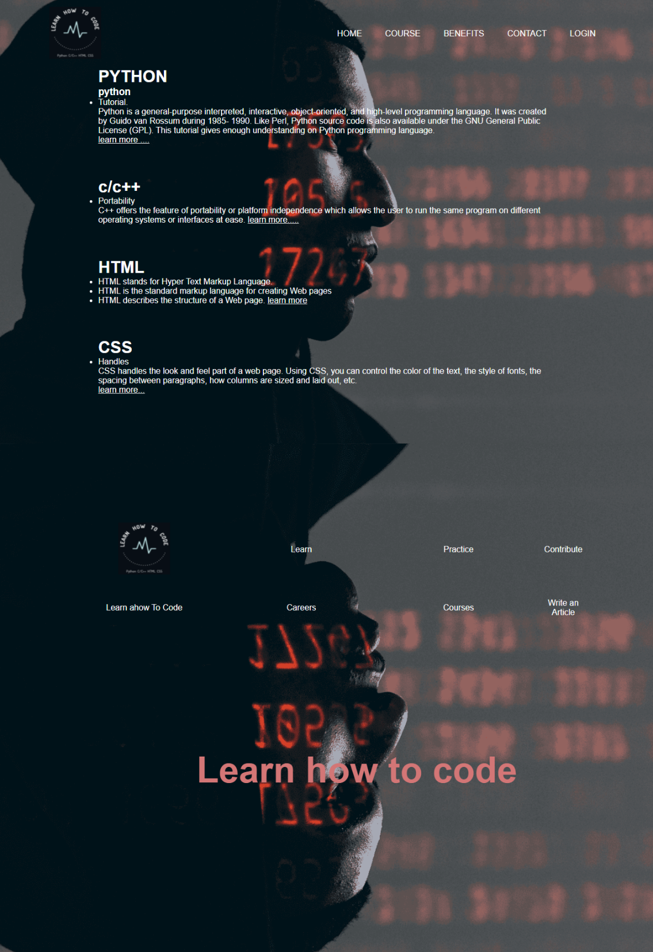
3.Benefits
When we click on benefits it open a new page know as benefits in benefits there are
same benefits and usres of prog languages.

Slide 13
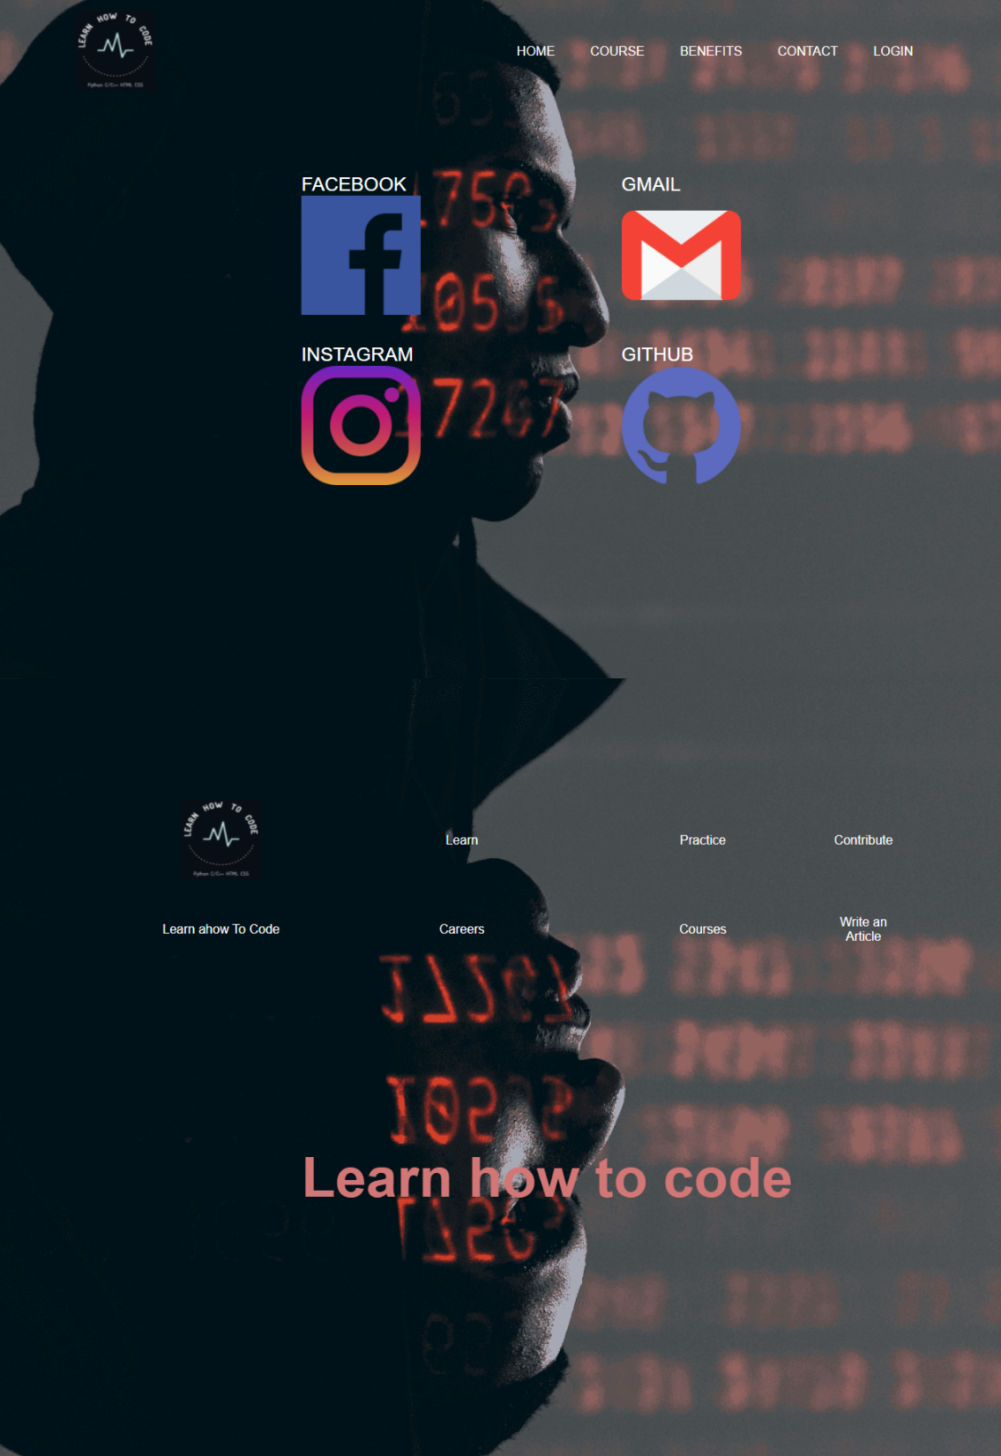
4.Contact
When we click on contact it open a new page know as contact in the contact page there
are mention some social media platform from that user can contact for any problem
facing in website

Slide 14
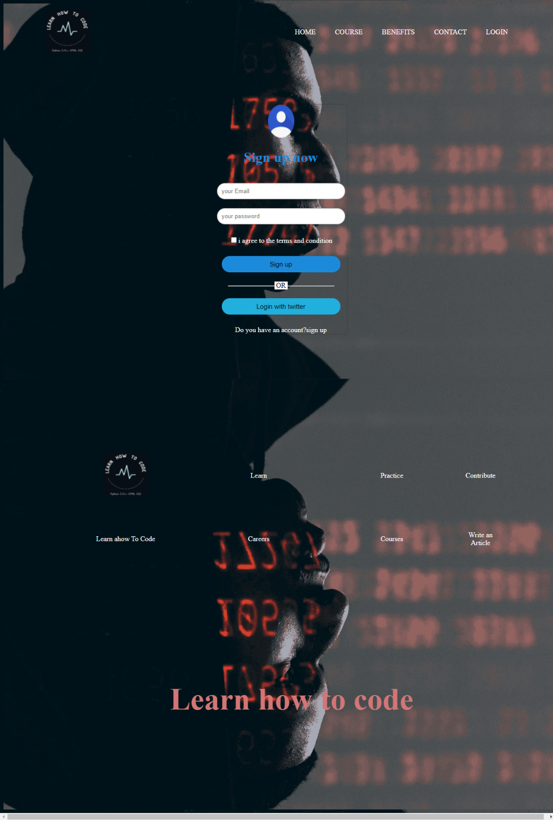
5.Login
When we click on login it open a new page know as login in login page there are again
two option sign up now and sign up so form that we can sign up through email and
password or we can directly make account using twitter and also login through twitter

Slide 15

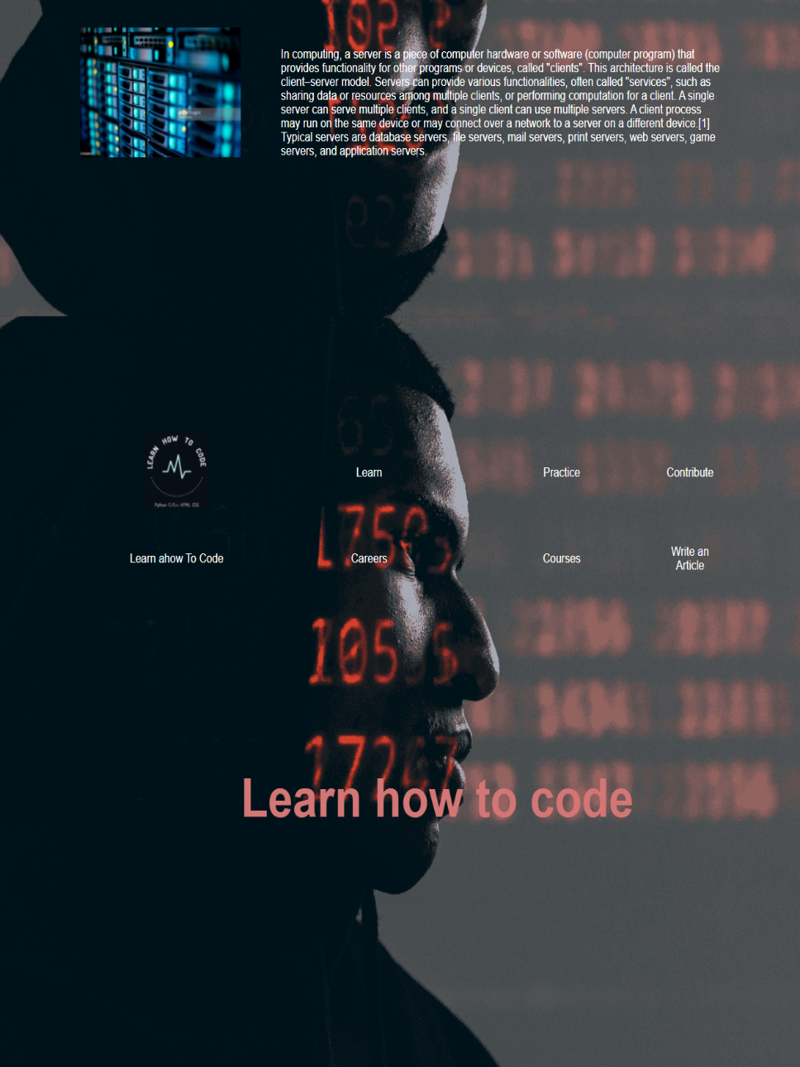
Screen Shots – Home Page
S. B. Jain Institute of Technology Management and Research
15

Slide 16
Courses Page

Slide 17
Benefits Page

Slide 18
Contact page

Slide 19
Login Page

Slide 20
Advantages & Applications
Hogwarts college Of Witchchart and Wizardry
S. B. Jain Institute of Technology Management and Research
20

Slide 21
References
Websites:
www.w3schools.com
www.sololearn.com
www.greatlearning.in
www.geeksforgeeks.org
S. B. Jain Institute of Technology Management and Research
21

Slide 22
Thank You
S. B. Jain Institute of Technology Management and Research
22

